Slide 1
Chongqing University of Technology
ATAI
Advanced Technique of Artificial Intelligence
Chongqing University of Technology
Xiaochen Hou^{1∗}, Peng Qi¹, Guangtao Wang¹, Rex Ying², Jing Huang¹,
Xiaodong He¹, Bowen Zhou¹
¹JD AI Research, Mountain View, CA
²Department of Computer Science, Stanford University, Stanford, CA
∗xclmm1994@gmail.com
Graph Ensemble Learning over Multiple Dependency Trees for Aspect-level Sentiment Classification
——NAACL 2021
2021.06.08 • ChongQing
Reported by Sijin Liu

Slide 2
Chongqing University of Technology
ATAI
Advanced Technique of Artificial Intelligence
Chongqing University of Technology
1.Introduction
2.Method
3.Experiments
4.Conclusion

Slide 3
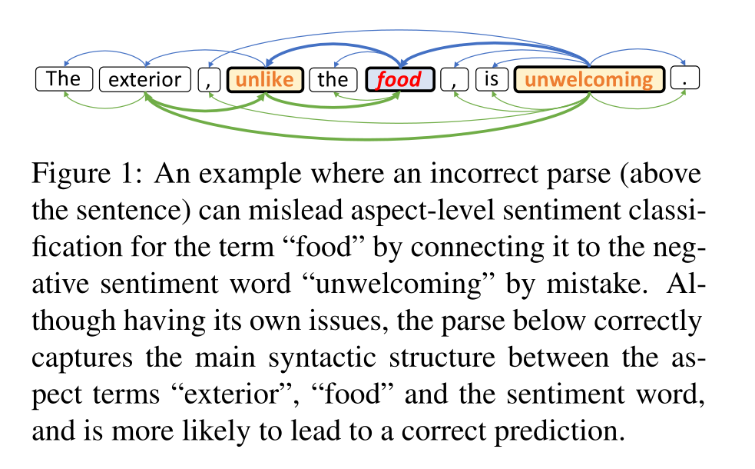
Introduction
Existing approaches are vulnerable to parsing errors —the added benefit from syntactic structure does not always prevail the noise introduced by model-predicted parses.

Slide 4
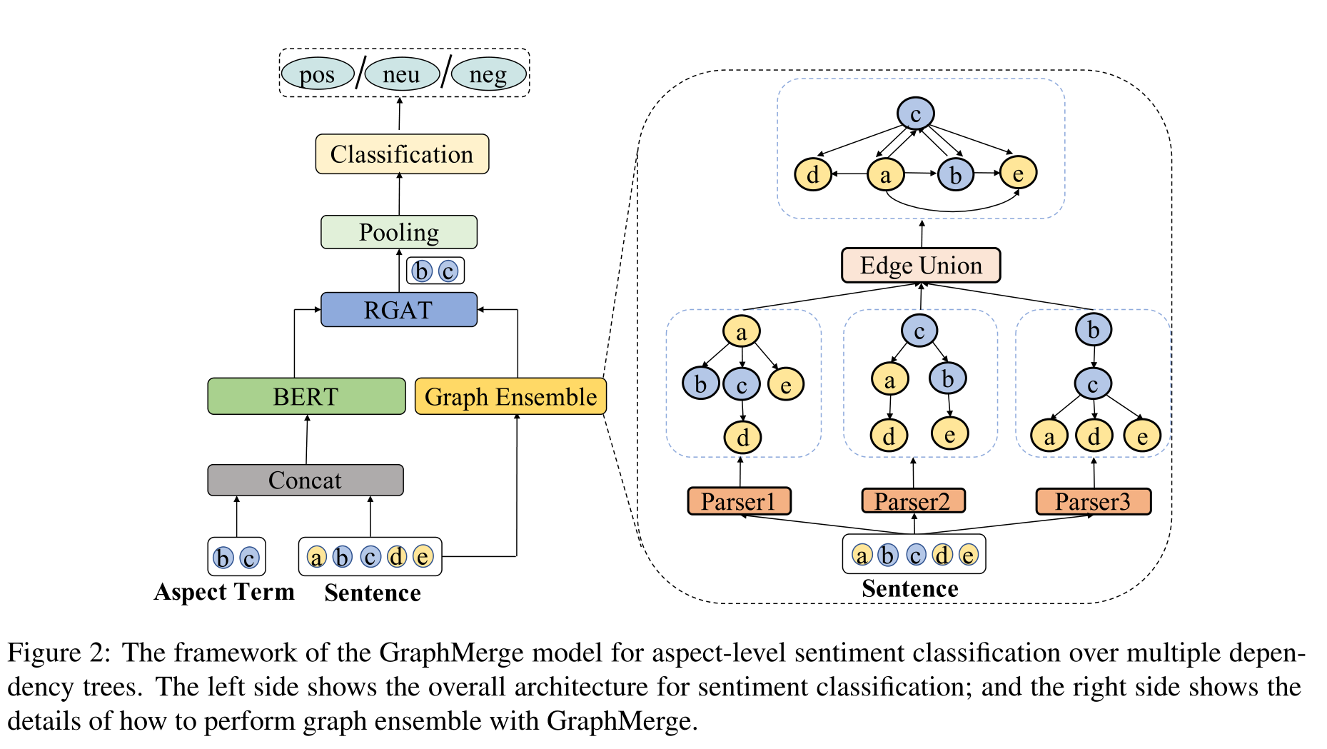
Method
Construct the input as
“[CLS] + sentence + [SEP] + term + [SEP]” and
feed it into BERT.
Specifically, we add a trainable position embedding matrix before feeding the resulting representation into RGAT.

Slide 5
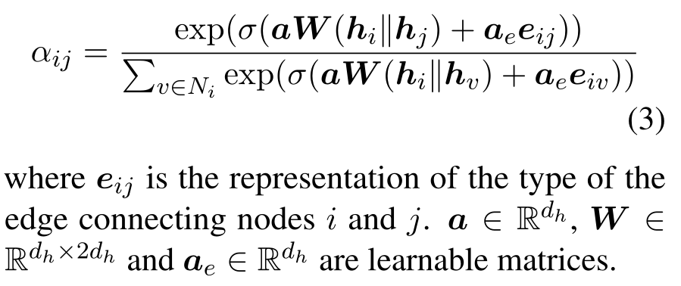
Method
Specifically, given a sentence {w₁, w₂, . . . , w_{n}} and M different dependency parses G₁, . . . , G_{M}, GraphMerge takes the union of the edges from all parses, and constructs a single graph G as follows

Slide 6
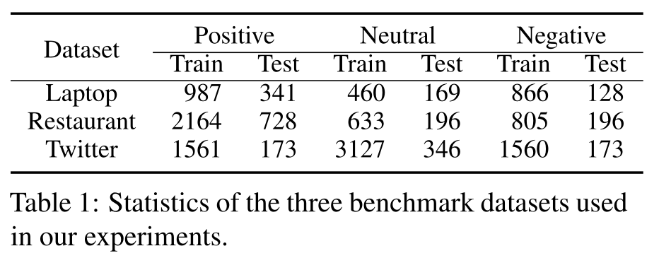
Experiments

Slide 7
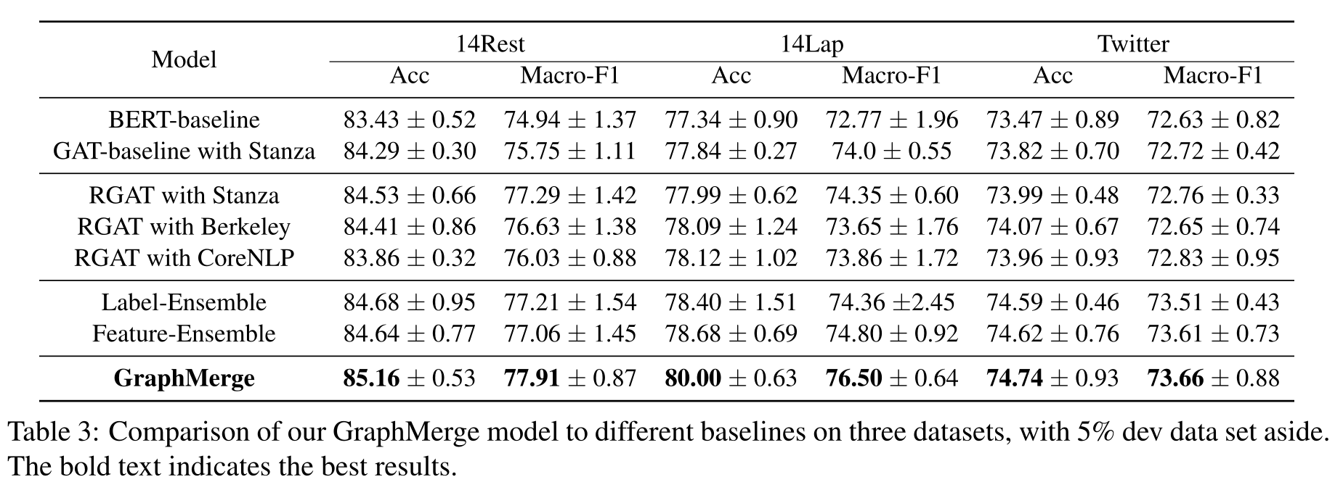
Experiments

Slide 8
Experiments

Slide 9
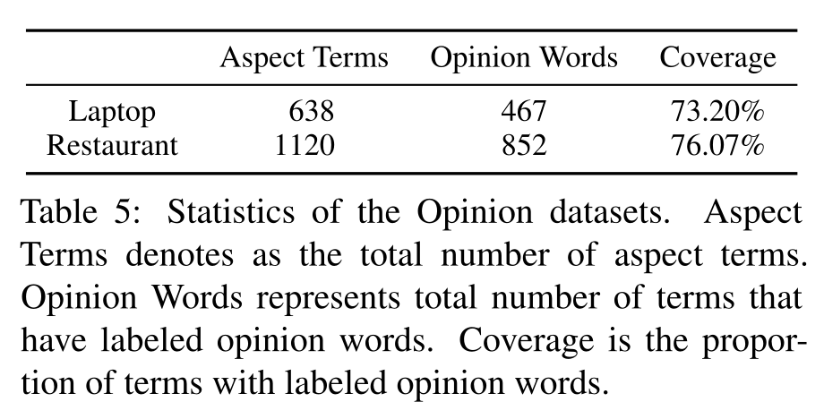
Experiments

Slide 10
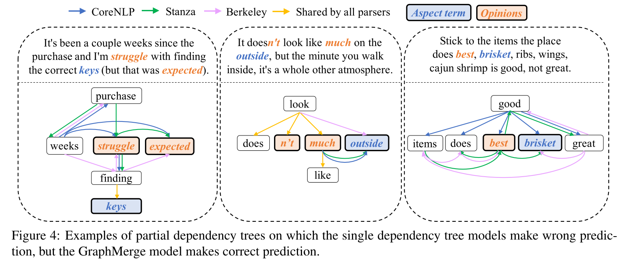
Experiments

Slide 11
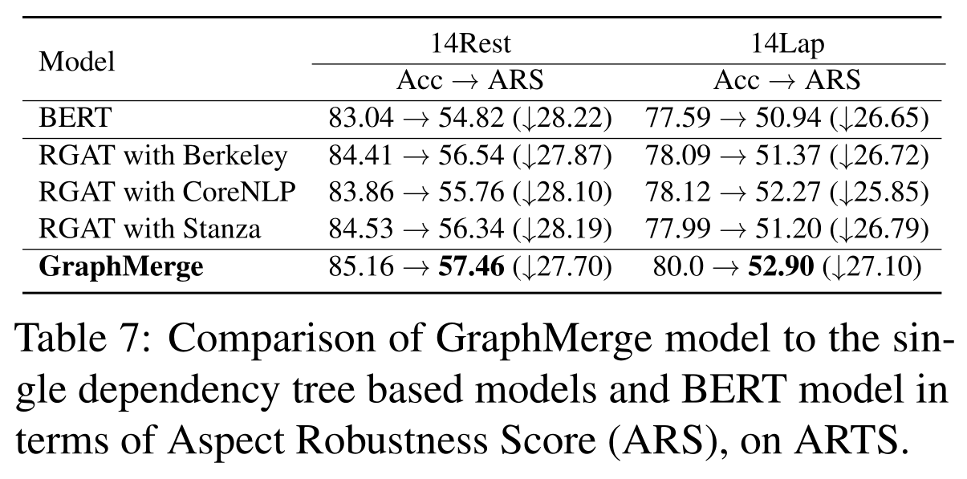
Experiments

Slide 12
Summary
We propose a simple yet effective graph-ensemble technique, GraphMerge, to combine multiple dependency trees for aspect-level sentiment analysis. By taking the union of edges from different parsers, GraphMerge allows graph neural model to be robust to parse errors without additional parameters or computational cost. With different edge types to capture the original syntactic dependency in parse trees, our model outperforms previous state-of-the-art models, single-parse models, as well as traditional ensemble models on three aspect-level sentiment classification benchmark datasets.

Slide 13
Thank you!

